Slide 1

NSRIC International School in Toronto (NIST)
Ontario (ON), Canada
Canadian Immigration Express
64314 Hotel front desk clerks
Wonda Grobbelaar
Faculty
NSRIC Inc.
London, ON, Canada
E-mail: wondag@nsric.ca
https://www.nistonline.ca

Slide 2
Module 5
(From Arrival to Rooming)

Slide 3

Hotel front desk clerks
A reminder of recommended reading material
3
3
3

Slide 4
Hotel front desk clerks
Can you remember what you have learned in the last session?
4
4
4

Slide 5
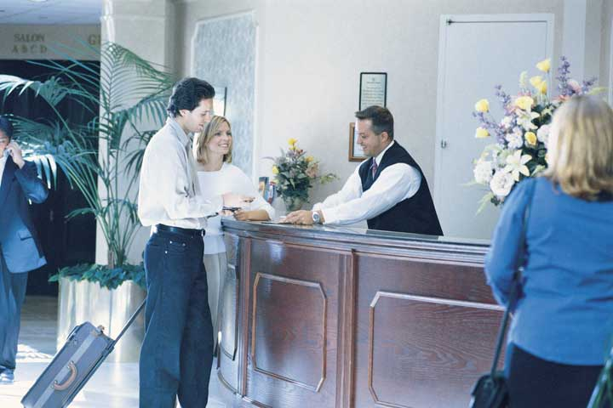
Hotel front desk clerks
Greeted on Arrival
5
5
5

Slide 6
Hotel front desk clerks
Greeted on Arrival
Moments of Truth
On arrival, the guest sees the hotel for the first time
First impressions do matter!
Valet’s Attendant
The first employee the guest often sees
Greets the guest, parks the car, and gives key back to guest
Brings the car from the parking lot whenever the guest needs it
Seen in upscale hotels OR where parking is a problem
May be contracted out to a specialized parking company
Fees charged for this service provide revenues to the hotel to cover cost of parking lot and insurance
Valet is compensated largely with tips
6
6
6

Slide 7
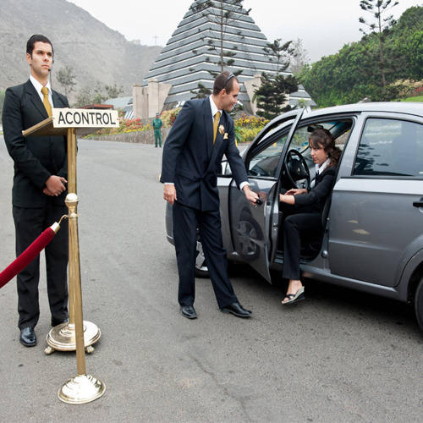
Hotel front desk clerks
Valet's Attendant
The valet's responsibilities include greeting guests, helping to unload luggage, parking cars carefully, and returning vehicles quickly when guests are ready to leave.
To be successful as a valet you must have the stamina to stand for extended periods of time while remaining vibrant and friendly.
7
7
7

Slide 8

Hotel front desk clerks
The Door Person
The Doorperson
Seen in luxury properties.
Opens the door, helps guest unload baggage from car, hails taxi for the guest, gives directions etc.
8
8
8

Slide 9
Hotel front desk clerks
Registration (1 of 6)
Guest Registration
Two types of guests.
With prior reservation.
Without prior reservation.
Handling guests with reservation.
Register the guest and assign a room if available.
Even if reservation is not found, assign room if available.
No need to tell the guest that we cannot find their reservation!
If sold out, then “walk” the guest.
Handling guests without reservations.
Get details of room requirements – dates, room type etc.
Assign room if available for duration of stay, decline if not.
9
9
9

Slide 10
Hotel front desk clerks
Registration (2 of 6)
Walk-in Guests
Come to the hotel needing a room without a reservation.
Registered, Not Assigned (RNA).
Arrivals for whom we have a vacated room, but that room is not ready yet (Room is known as “on change”).
Happens when hotel is very busy with many conventions.
Guest is assigned a specific room and may be allowed to bill charges to that room.
May be assigned another room temporarily if guest insists.
Early arrivals.
The check-in hour.
10
10
10

Slide 11
Hotel front desk clerks
Registration (3 of 6)
Room is given, but guest is charged for “previous day”.
Not a good idea to charge – Hotel wins today, but….
Better to build goodwill by permitting early check-in.
Hotel wins by clearing the check-in rush early.
Waiting Lines.
Long Lines Equal Poor Service.
People have less patience today in the “instant” society.
If made to wait, guests assume hotel is incompetent.
11
11
11

Slide 12
Hotel front desk clerks
Registration (4 of 6)
Better lines through queuing theory.
Arrival Population.
Service Population.
Queue Discipline.
Service Discipline.
Creative Solutions.
Better lines through innovation.
Self-Check-in Kiosks.
Mobile Apps.
12
12
12

Slide 13
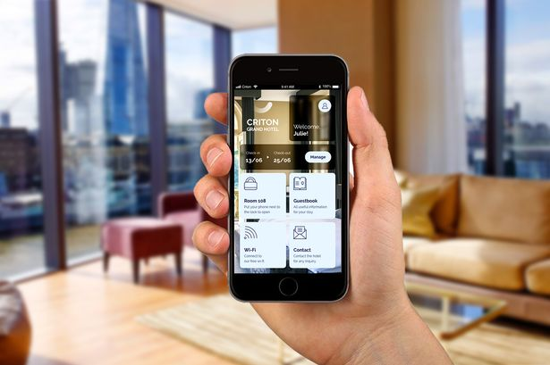
Hotel front desk clerks
Mobile App for Check In
13
13
13

Slide 14
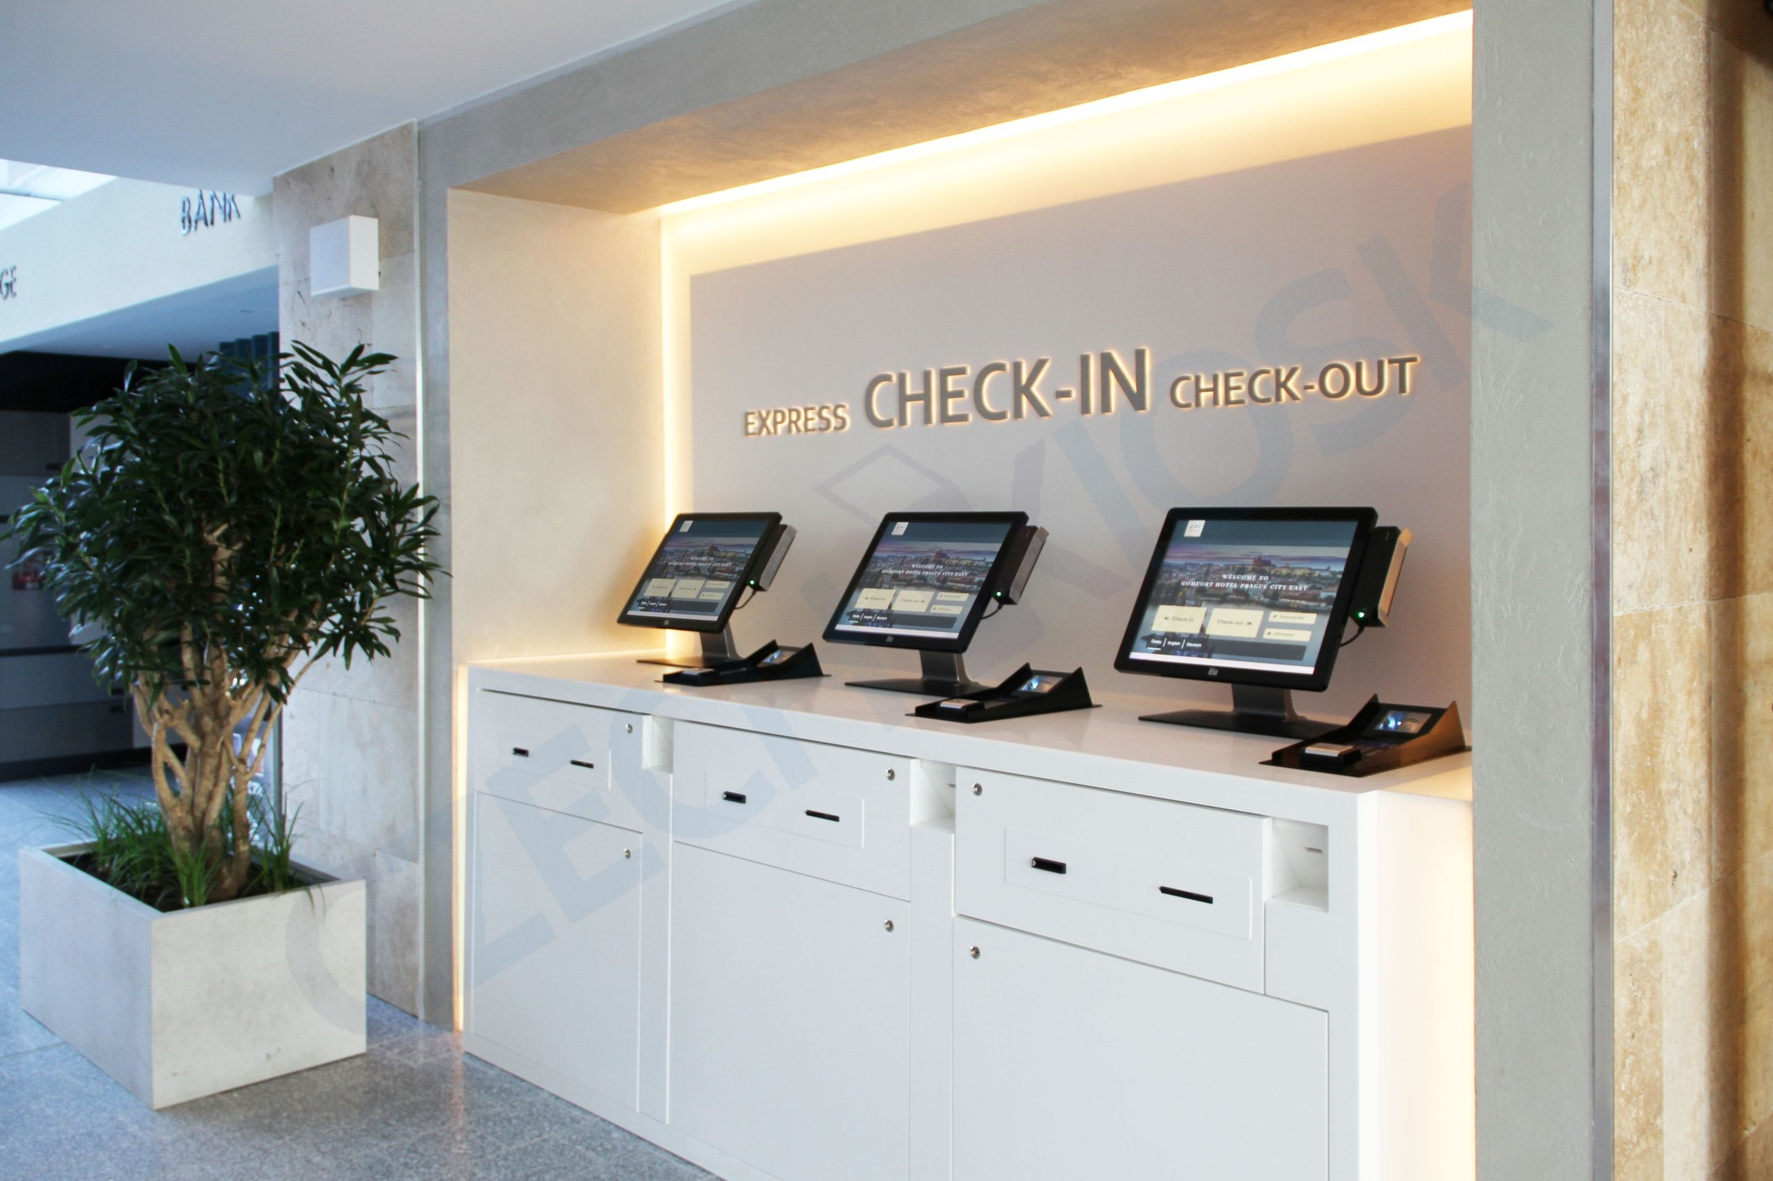
Hotel front desk clerks
Self help Kiosks
14
14
14

Slide 15
Hotel front desk clerks
Registration (5 of 6)
The Registration Card
Card asking for details of the guest along with a signature to establish a contractual relationship.
Release of Registration Information.
Contents of the card:
Name and Address.
Number in the party.
Room Number.
Date of Departure.
May be asked to initial to reduce overstay/under stay problems.
15
15
15

Slide 16
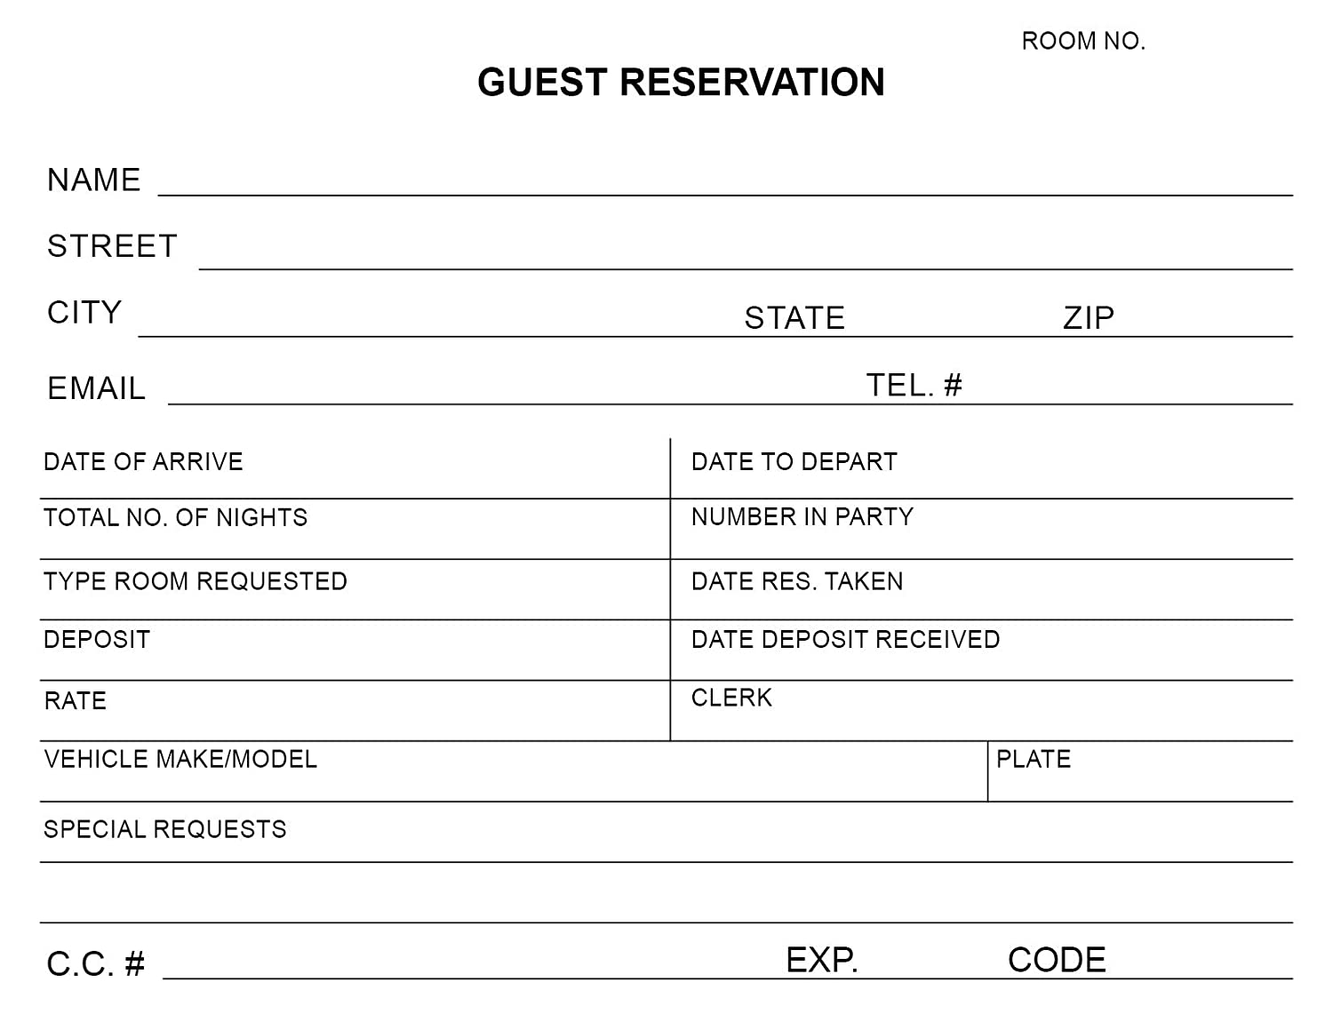
Hotel front desk clerks
Registration Card
16
16
16

Slide 17
Hotel front desk clerks
Registration (6 of 6)
Rate
Agent’s identification.
Folio number.
Each guest account is assigned a unique folio number for identification and control purposes.
Used to have sequentially numbered forms earlier.
Now computer generates unique number, so less of an issue.
Disclaimer of liability.
Points of Agreement.
Guests may be asked to initial against the rate etc., to avoid disputes.
17
17
17

Slide 18
Hotel front desk clerks
Assignment of rooms (1 of 5)
No-smoking rooms
Ask guest to initial the card for non-smoking room.
Alert guests to charges for smoking –$200-500!!
Pets
This is the choice of the hotel.
Good idea to require the pet to be registered in case of disputes.
18
18
18

Slide 19
Hotel front desk clerks
Assignment of rooms (2 of 5)
The Assignment Process
Blocking the Room.
Not needed if all rooms are identical.
Ensures that special requests will be accommodated.
V I P s, Handicapped access, non-smoking etc.,
Enables faster check-in by avoiding confusion.
Clearly identifies tight or over-booked positions.
Pre-assignments need to be changed with changes, cancellations etc.,
19
19
19

Slide 20
Hotel front desk clerks
Assignment of rooms (3 of 5)
Choosing, Selling, The Room
Algorithms and Property Management System.
Computer program to match reservations with rooms on a priority basis.
Management can change priority issues.
Examples – To rotate rooms, to fill a building, save energy.
Upgrades
Giving the guest a better room at a lower price.
Ex: Giving the guest a luxury suite for the price of a single room.
Used to avoid “walking” the guest.
20
20
20

Slide 21
Hotel front desk clerks
Assignment of rooms (4 of 5)
VIP’s.
Did not Stay.
A guest who registers but does not stay.
Could be due to dissatisfaction or an incident in the hotel.
Could also be due to personal issues not related to hotel.
Maybe the guest wants to move to main convention hotel from overflow hotel!
Call the convention hotel and check first!
21
21
21

Slide 22
Hotel front desk clerks
Assignment of rooms (5 of 5)
Establishing Credit and Identity.
First priority is to establish identity.
Ask for photo ID for all-cash guests.
Credit verification less of an issue now with widespread use of credit cards.
“Run” card on arrival to verify validity.
Cash Only guests.
Guests pays room rent in cash, in advance, and is required to pay cash for all other transactions.
It is legal to collect cash in advance for the room.
However, less common these days with credit cards.
Problem of other departments extending credit anyway.
Need to collect the money on the same day.
22
22
22

Slide 23
Hotel front desk clerks
Rooming the Guest (1 of 2)
Uniformed Service
Valet Parking, doorpersons, concierges, hotel security, and bell staff.
Have maximum guest contact.
Have first and last guest contact.
To many guests, remember they are the “hotel”.
Have opportunity to sell hotel services.
Rotation of Fronts.
Bell staff make money through tips!
23
23
23

Slide 24
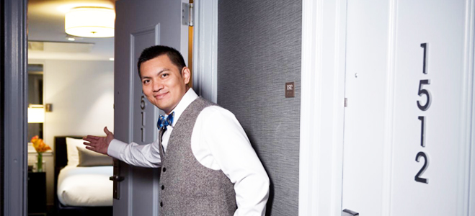
Hotel front desk clerks
Rooming the Guest (2 of 2)
24
24
24

Slide 25
Hotel front desk clerks
Green Hotels (1 of 3)
Ecotourism
Some Specifics.
An attempt to reduce the environmental footprint of the hotel.
Designing hotel as LEED certified property.
Using renewable energy, such as solar or wind.
Recycling waste water.
Recycling waste paper and organic wastes.
Using energy saving lights and appliances.
Sheets and towels changed only on request.
25
25
25

Slide 26
Hotel front desk clerks
Green Hotels (1 of 2)
LEED Certified Property
LEED stands for Leadership in Energy and Environmental Design.
It's an internationally accepted green building certification system designed by the US Green Building Council (USGBC), a non-profit organization consisting of members from real estate, construction, finance, and technology sectors.
26
26
26

Slide 27
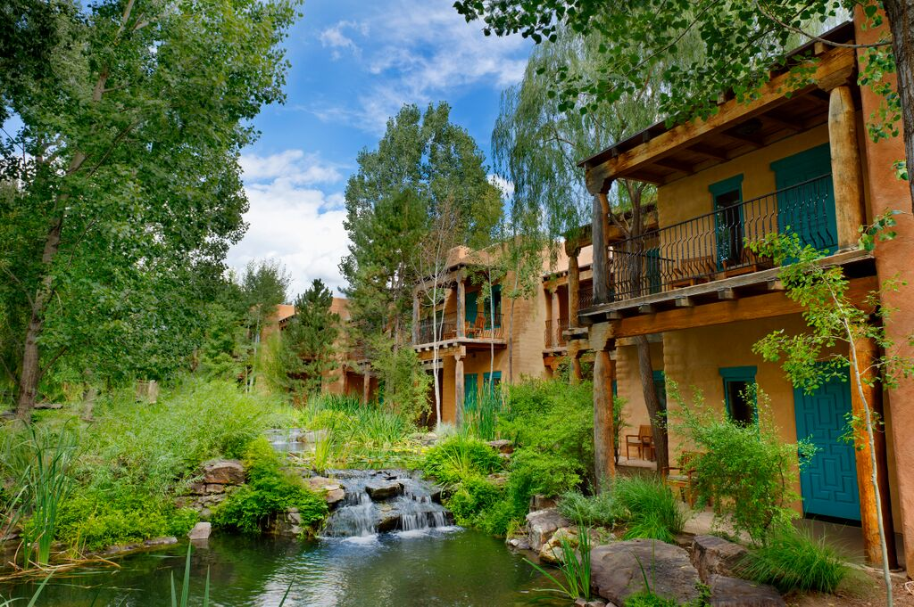
Hotel front desk clerks
Green Hotels (1 of 3)
27
27
27

Slide 28
Good Luck
and
Thanks for Attending this Course!
28
28
28

